Slide 1


Digitalization of Pension System in Mexico
Benefits and Implications
Jocelyn Alba & Juan Carmona
National Autonomous University of Mexico (UNAM)
May 11th – May 15th 2020

Slide 2




About the speaker
Jocelyn G. Alba Arellano
Academic & Risk Manager
Actuarial Science (UNAM, 2018), High Technology Management (Samara University, 2017)
Juan F. Carmona S.
Academic & Financial Researcher
Master in Financial Economics (UNAM, 2019), Graduate in Economics (ITAM, 2016) & Actuarial Science (UNAM, 2015)
UNAM – Scotiabank Mexico
Risk Manager in Liquidity, Interest Rate and Investment Funds Directorate
Harvard Project for Asian and International Relations Delegate
World Bank Impact Challenge, first place
UNAM – Bank of México
7 years of professional experience in the Macroeconomic Analysis Directorate of Banco de México
9 years of teaching experience in the Faculty of Sciences
Recognized by Inroads de México, A.C. as "Teacher who leaves a mark"

Slide 3
Digitalization of Pension System in Mexico
Introduction and Context
  Retirement Savings System in Mexico
  Demographic and Labor Context
  Non – Conventional Employment
SAR Digitalization Strategy
  Challenges, Scope and Limitations
Results
Public Policy Recommendations
Conclusions

Slide 4
Digitalization of Pension System in Mexico
Introduction and Context
  Retirement Savings System in Mexico
  Demographic and Labor Context
  Non – Conventional Employment
SAR Digitalization Strategy
  Challenges, Scope and Limitations
Results
Public Policy Recommendations
Conclusions

Slide 5


Introduction and Context
Two suppliers
Sector Private Public
Entry into force 1997 2008
(Defined) Contributions 6.5 % 11.3%
  Employee 1.125 % 6.125 %
  Employer 5.15 %
  State 0.225 % 5.175 %

Slide 6
Introduction and Context
Social Fee
Voluntary Savings

Slide 7
Introduction and Context
Contributions are managed by privates companies, named AFORE
Funds are invested in financial markets by specialized agencies, named SIEFORES Básicas (SB)
Younger workers Older workers
Riskier funds Conservative funds
SB4
SB3
SB2
SB1
SB0

Slide 8
Introduction and Context
Retirement requirements
  65 years old
  1,250 weeks or 25 years of work
  Guaranteed Pension (PG)

Slide 9



Introduction and Context
Some replacement rates estimations
        Between 32% and 66% Around 26%
        Minor than 30% Between 18% and 30%
Own estimation

Slide 10
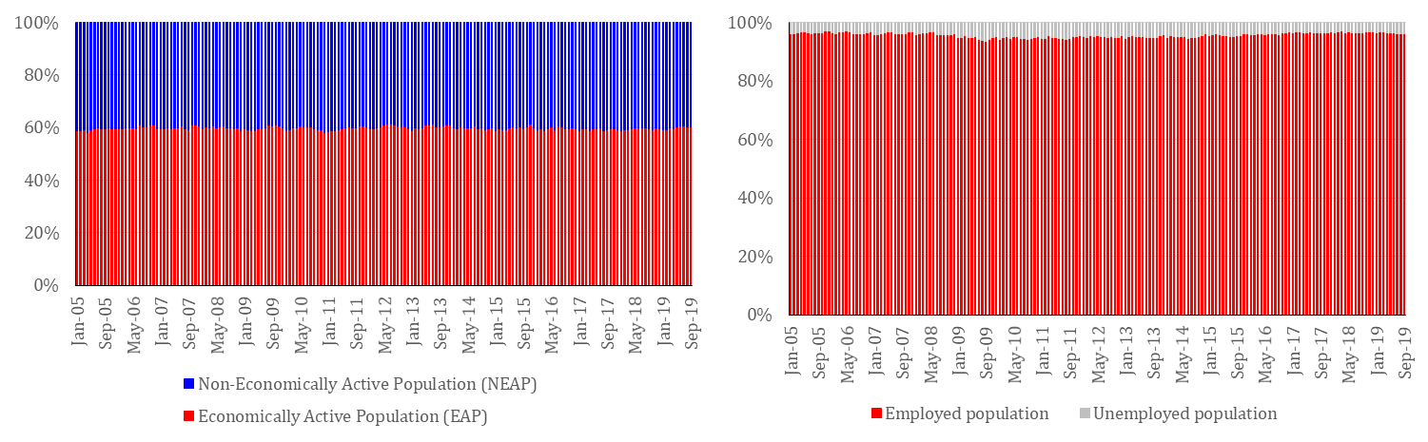
Introduction and Context
Population in Mexico, 126 million
  EAP, 57.3 million (45.5%)
    Employed 55.2 million (96.2%)

Slide 11
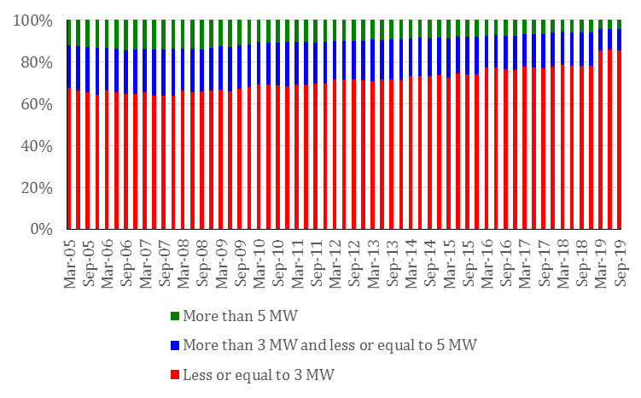
Introduction and Context
Employed Population's wages

Slide 12
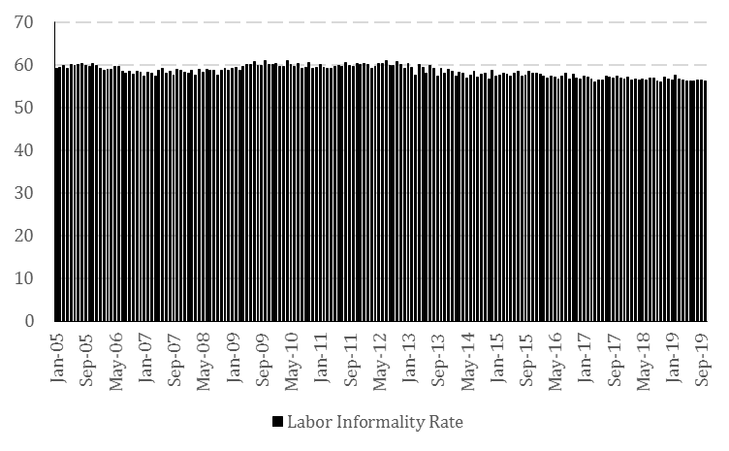
Introduction and Context
Labor Informality Rate

Slide 13
Digitalization of Pension System in Mexico
Introduction and Context
  Retirement Savings System in Mexico
  Demographic and Labor Context
  Non – Conventional Employment
SAR Digitalization Strategy
  Challenges, Scope and Limitations
Results
Public Policy Recommendations
Conclusions

Slide 14
SAR Digitalization Strategy
2013. Diagnosis
  Weak involvement of workers with their retirement savings
  The quality of attention for workers by AFORE was not the optimum
  It was extremely complex to make voluntary savings.
Context
  Low replacement rates
  Rising population aging
  Technological growth
(Natural) solution: Digitalization

Slide 15


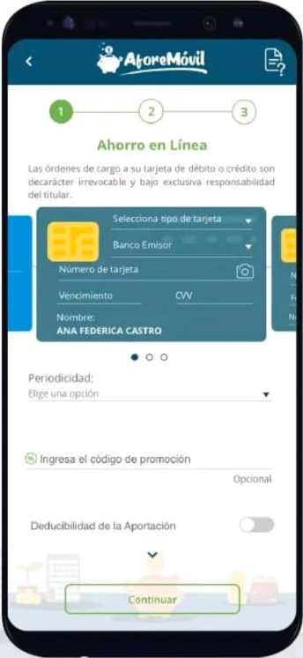
SAR Digitalization Strategy
  An unique electronic file for each worker
  Identification through biometric personal data
  A central website that offered a range of possibilities to simplify the procedures with the SAR
  A mobile services application to expand the coverage

Slide 16



SAR Digitalization Strategy
Background and Expectations
  Digital technologies might simplify procedures, reduce fraud and improve financial and actuarial planning (Keller and Tapia, 2019)
  Web applications can contribute to decision making, for example, in voluntary savings (OECD, 2018)
Previous experiences

Slide 17
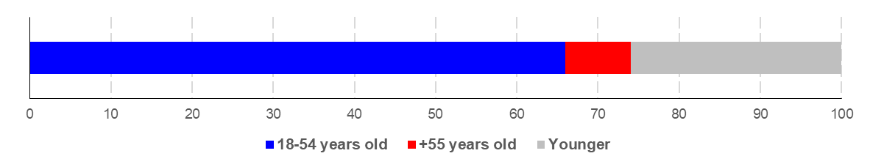
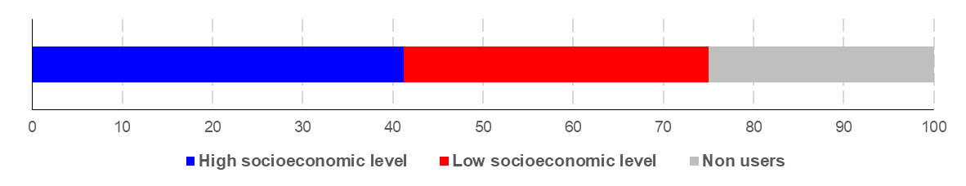
SAR Digitalization Strategy
Scope and Limitations
  Internet users
  Financial services users

Slide 18
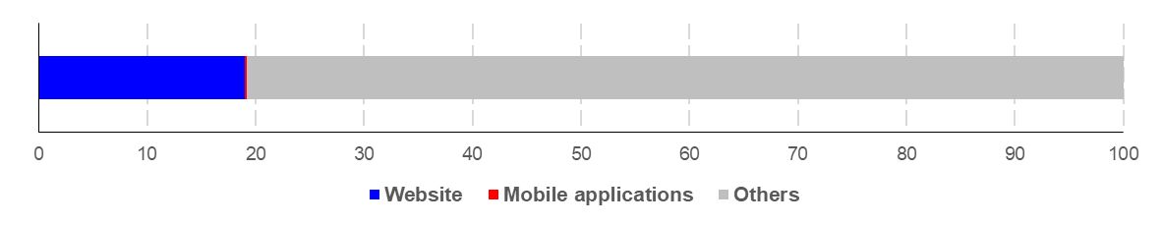
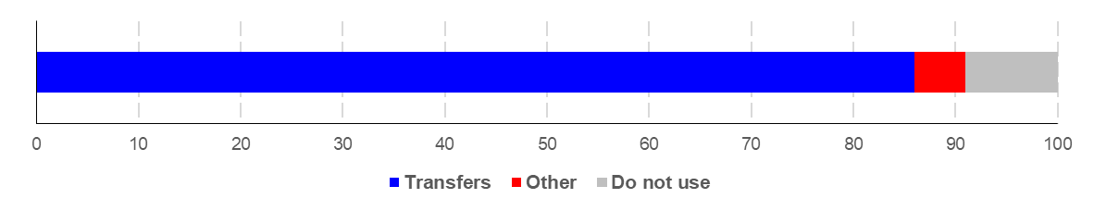
SAR Digitalization Strategy
Scope and Limitations
  Ways used to contract financial services
  Use of electronic media for financial services

Slide 19
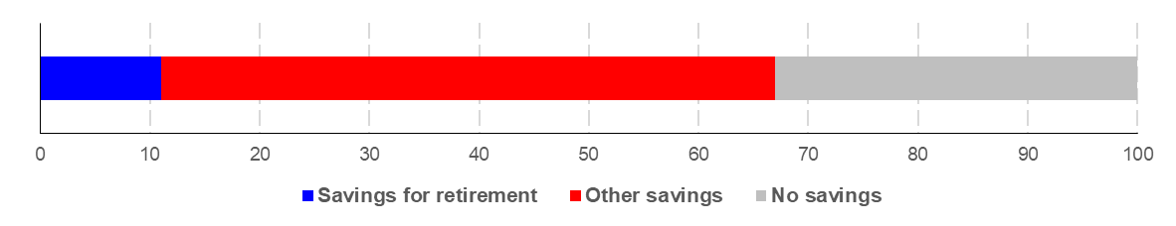
SAR Digitalization Strategy
Scope and Limitations
  Savings
  CONSAR recognized:
    12 millions of migrants
    14 millions of independent workers
    Up to 39 million of underage who could register in an AFORE and make voluntary savings
    Formal workers

Slide 20
SAR Digitalization Strategy

Slide 21
Digitalization of Pension System in Mexico
Introduction and Context
  Retirement Savings System in Mexico
  Demographic and Labor Context
  Non – Conventional Employment
SAR Digitalization Strategy
  Challenges, Scope and Limitations
Results
Public Policy Recommendations
Conclusions

Slide 22
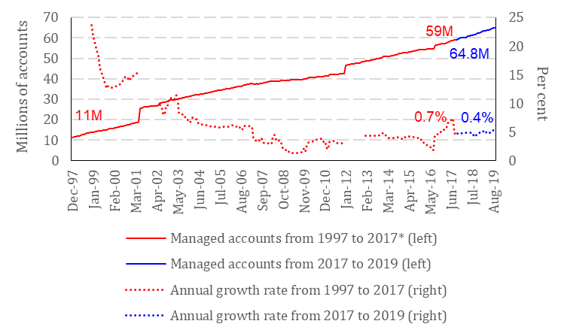
Results
Managed accounts
  No significant changes
  Growth associated to the inertia of the system
  The creation of AFORE accounts in relation to job creation did not present significant changes

Slide 23
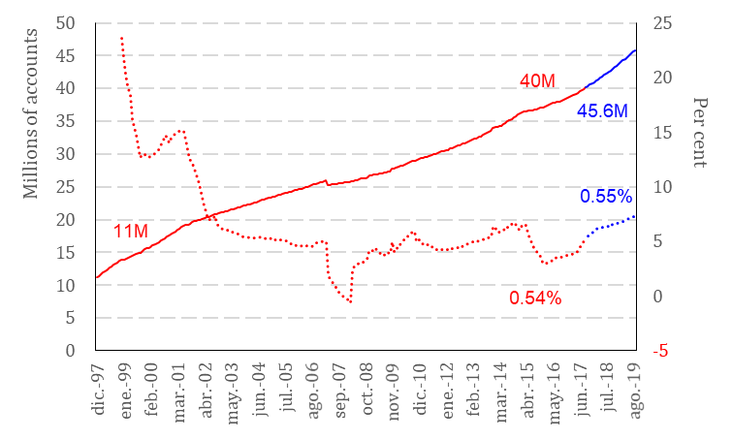
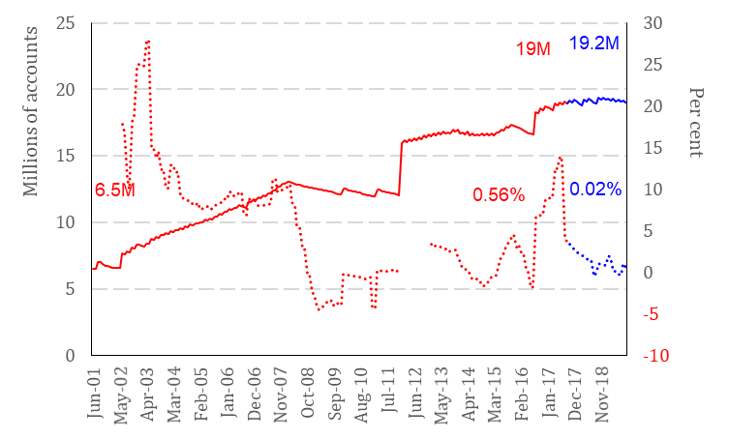
Results
Registered accounts
  More than 98% of new accounts were registered since 2017
  The number of registered accounts for each formal employment created reflects an increase
Assigned accounts
  No significant changes in the number of accounts

Slide 24
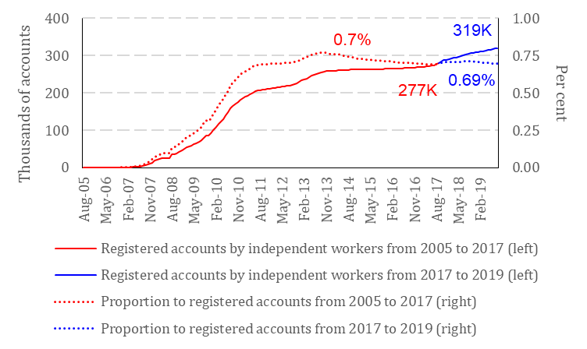
Results
Independent workers
  Slight growth in the number of accounts
  Smaller weight in the total
  The number of independent workers continues growing

Slide 25
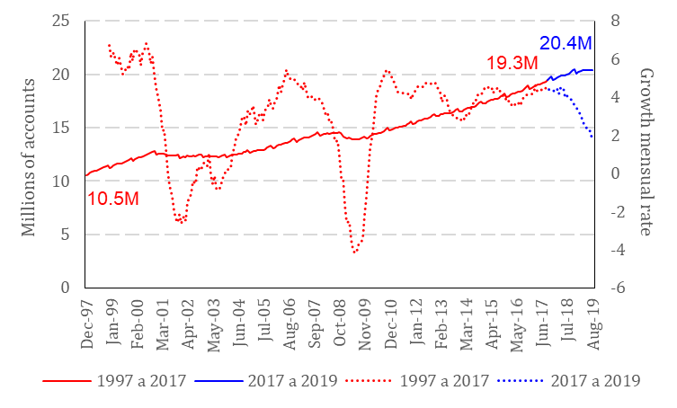
Results
Employment
  The number of accounts created for each formal job created decreased from 5.5 to 5.1
  The number of accounts registered for each formal job created increased from 3.3 to 5.0

Slide 26
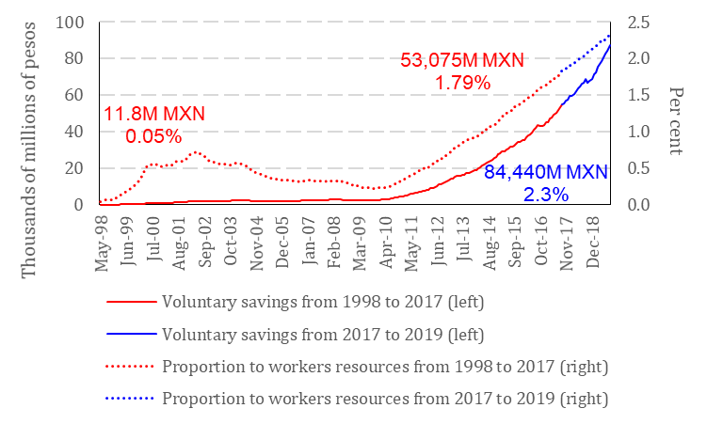
Results
Voluntary savings
  The growth rate remains in both stages
  The number of accounts with voluntary savings increased

Slide 27
Results
Summary
  5.6 million of accounts registered, 14%
  About 41 thousands accounts registered by independent workers
  3.4 million of accounts with new voluntary savings
Not achieved
Partially achieved
Achieved

Slide 28
Digitalization of Pension System in Mexico
Introduction and Context
  Retirement Savings System in Mexico
  Demographic and Labor Context
  Non – Conventional Employment
SAR Digitalization Strategy
  Challenges, Scope and Limitations
Results
Public Policy Recommendations
Conclusions

Slide 29
Public Policy Recommendations
CONSAR could expand the advertising campaigns
Extension of the dissemination campaign by CONSAR
  focused on workers who have no knowledge or interest on SAR
  Include a campaign to disseminate the mobile application with all the advantages
Creation of programs and incentives for the inclusion of informal and independent workers to SAR
  A scheme, which the State subsided once the worked made retirement savings contributions for a term previously defined

Slide 30
Public Policy Recommendations
Include artificial intelligence algorithms
  Push notifications to encourage voluntary savings according to the user profile
  Expand the campaign in order to approach all workers; formal, informal and independent; disseminating the SAR benefits based on each saver needs

Slide 31
Digitalization of Pension System in Mexico
Introduction and Context
  Retirement Savings System in Mexico
  Demographic and Labor Context
  Non – Conventional Employment
SAR Digitalization Strategy
  Challenges, Scope and Limitations
Results
Public Policy Recommendations
Conclusions

Slide 32
Conclusions
« Afore Móvil » shows mixed results: it has not brought the assigned workers or independent workers to the SAR but it has favored the registration of workers recently incorporated into AFORE and has increased the number of accounts with voluntary contributions
Digitalization strategy has not been correctly focused
The recent reforms to Mexican pension system have not included the new forms of employment. The labor context was adapted to the digital era before regulations.

Slide 33
Thank you for your attention
Contact details :
Juan Francisco Carmona Sánchez Jocelyn G. Alba Arellano
Avenida Universidad 3000
Post Code 04360, Mexico City
Mexico
juanf_carsan@ciencias.unam.mx jocelyn_arellano@ciencias.unam.mx
https://www.actuarialcolloquium2020.com/

Slide 34
Disclaimer:
The views or opinions expressed in this presentation are those of the authors and do not necessarily reflect official policies or positions of the Institut des Actuaires (IA), the International Actuarial Association (IAA) and its Sections.
While every effort has been made to ensure the accuracy and completeness of the material, the IA, IAA and authors give no warranty in that regard and reject any responsibility or liability for any loss or damage incurred through the use of, or reliance upon, the information contained therein. Reproduction and translations are permitted with mention of the source.
Permission is granted to make brief excerpts of the presentation for a published review. Permission is also granted to make limited numbers of copies of items in this presentation for personal, internal, classroom or other instructional use, on condition that the foregoing copyright notice is used so as to give reasonable notice of the author, the IA and the IAA's copyrights. This consent for free limited copying without prior consent of the author, IA or the IAA does not extend to making copies for general distribution, for advertising or promotional purposes, for inclusion in new collective works or for resale.

